Slide 1
IBM Spectrum LSF Mehr als nur ein Scheduler ZKI-Arbeitskreis Supercomputing Herbsttreffen 2021 8.10.2021 Christof Westhues IBM Spectrum Computing

Slide 2
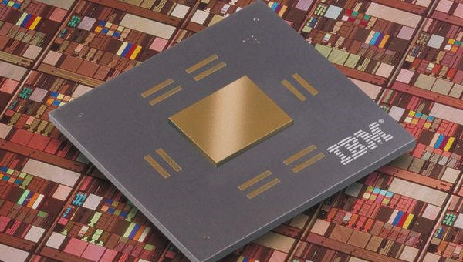
IBM Spectrum Computing products are used by 23 of the 30 largest commercial enterprises in the world including …
Numerous Genomics, Bioinformatics, and Children's Hospitals
Top 3
Cancer Centers in
the US
10 of top 12 Automotive Companies | 23 of top 25 Electronic Companies | 7 of top 10 Aero & Defense Companies
Notes:
https://www.relbanks.com/worlds-top-banks/top-investment-banks

Slide 3
High Performance Computing
Design / Simulation / Modeling
High Performance Analytics
Trade / Risk Analytics
‘New-gen Workloads’
Hadoop, Spark, Containers
Workload Aware
Scheduling
Shared Resource
Management
Heterogeneous Servers & Storage
Flash
Disk
Tape
Power
x86
Linux on z
Sparc
ARM
docker
VM
IBM Cloud
Hybrid Cloud Infrastructure

Slide 4
IBM Spectrum LSF Suites 10.2
Suite for Enterprise
Suite for HPC
Suite for Workgroups
Application
Centric User Portal
Workflow Automation
Software License Optimization
IBM Platform MPI
IBM Spectrum MPI
Lightweight Reporting & Dashboards
Intelligent
Data Staging
High Performance Workload Scheduling
Cluster Deployment and Monitoring
Hybrid Cloud Auto-scaling
Enterprise Scalability
Power
x86
aarch64

Slide 5
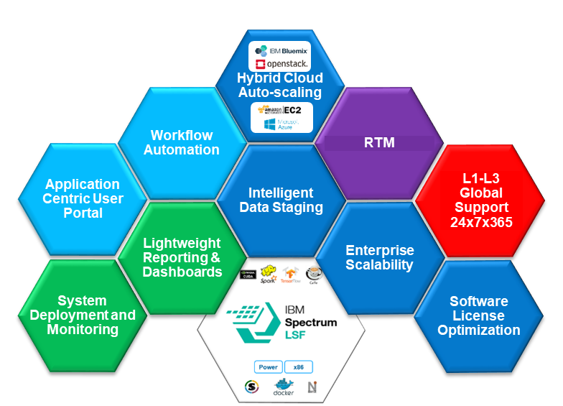
IBM Spectrum Software - complete end to end solution
Build it Yourself
Spectrum
Scale
Limited Support
Other Scheduler

Slide 6
Spectrum LSF Over 25+ Years of Sustained Agility! Over 2,000 Customer Driven enhancements since 1992! “A product imagined by customers and built by IBM”

Slide 7
IBM Spectrum LSF – The HPC Swiss Army Knife

Slide 8
Key LSF Features Purpose Built for HPC
Unmatched Scheduler Performance
Cloud Bursting (Host Factory)
Control Groups and Affinity
Container Support (Docker, etc.)
Compute Units & Job Packing
Event/Relaxed Scheduling
9th Generation GPU Support*
Spectrum LSF Application Center
Spectrum LSF Data Manager
Global Fairshare
Multi Cluster
Session Scheduling
Block Scheduling
Multi-Pass Resource Requirements
Absolute Priority Scheduling
Spectrum LSF RTM
Guaranteed Resources
Multi-threaded Dispatch
Key Pending Reasons
Start Time Prediction
Dynamic Resource Scheduling
Resource Preemption
License Scheduling
Resizable Jobs
Backfill Scheduling
Delegation of Administrative Authority
Alternative Resource Requirements
Application Profiles
Large Array Support
Plan Based Scheduling
LSF Simulator

Slide 9
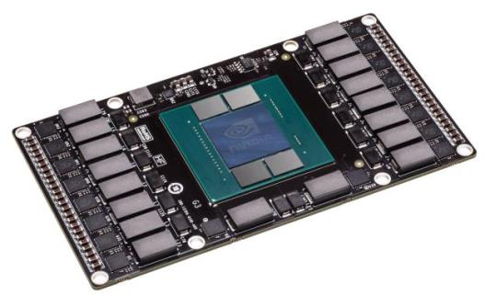
NVidia GPGPU Support
Enforcement of GPU allocations via Control Groups (cgroups)
Dynamic mode switching
Exclusive allocation and round robin shared mode allocation.
CPU-GPU Affinity
Boost Control
Power Management
Memory Reservation
Zero Config Installation
NVLink Affinity
Multi-Process Server (MPS) Support
Pascal & DCGM Support
GPU behavior monitoring
GPU configuration management
GPU policy oversight
GPU health and diagnostics
GPU accounting and process statistics
© IBM Corporation
9
Notes:
LSF has provided GPU support for many years.
We provide separate elim’s for scheduling and extended monitoring – so you can choose what you want to collect.
We place all jobs in a cgroup along with the allocated gpu(s) to ensure that only jobs requesting gpu’s have access.
Most applications try to open gpu0, this means that when two or more gpu’s are in shared mode, most applications will use “gpu0” – to avoid this, we logically rotate the value of gpu0 on a per job basis, to spread jobs across gpu’s
We ensure we allocate gpu’s and cpu’s on the same pci bus
For multi-gpu jobs we disable boost to ensure they all run at the same frequency
When gpu’s aren’t being used, they are put in a minimum power state
MPS provides a method for multiple MPI jobs to share one gpu
DCGM will be supported in 3Q and provides additional control and accounting information.

Slide 10
Dynamic flexibility to balance business priorities
Resource Connector Interface
(Host Factory)
IBM Spectrum LSF
“hosts” are dynamically created on demand & returned when no longer needed
IBM Cloud
Workload driven demand
Menu of Available Host Types
Methods for Creation
Notes:
In LSF9 we had an add-on called “Dynamic Cluster” – this allowed LSF to request VM’s to be created, based on workload requirements. However, this only worked with Platform Cluster Manager 3.2 – so not very flexible.
In LSF10 we have introduced a resource connector interface (known internally as the “host factory”) to extend this to an arbitrary resource provider.
The host factory presents “a menu” of “hosts” it knows how to create – and LSF asks for those hosts based on the real workload demand.
Support for OpenStack (Nova) is included with LSF10, connectors for other providers will be released. The connector interface is script based and can easily be extended/customised.

Slide 11
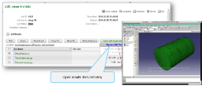
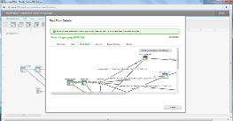
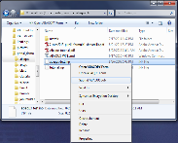
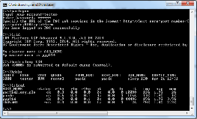
Cloud Bursting with LSF
LSF MultiCluster forwards specific workloads to the cloud based on site defined policies.
LSF
Scheduler
LSF
Scheduler
Single Connection between on-prem and Cloud
Compute Nodes
Job Submission
On Premise On Cloud

Slide 12
Cloud Bursting with LSF
LSF’s Resource Connector dynamically resizes the pool of hosts in the cloud based upon workload demands and policies.
LSF MultiCluster forwards specific workloads to the cloud based on site defined policies.
LSF
Scheduler
LSF
Scheduler
Compute Nodes
Job Submission
On Premise On Cloud

Slide 13
Today’s Challenges with Containers in a Production Environment
Security of the run time environment:
Docker users have to be placed in the “docker user” group
Docker group members have “sudo” privileges – run jobs as root
Not really an issue when docker is being used to run services started by root - but a potentially serious issue when end users are allowed to run arbitrary jobs.
Many Businesses have concerns over allowing users to “install” and run an arbitrary application
Auditability, accountability, security of data.
Multiple different container technologies – Docker, Shifter, Singularity, rkt, runc etc
Containers may be portable, but the runtimes have different usage

Slide 14
Enhanced Container Support
LSF 10.1+ includes an enhanced container support that addresses these issues:
LSF will directly start the container removing the need for the user to be in the Docker user group. This means the user never gains elevated privileges.
Administrators have control (via lsb.applications) of which containers are allowed to be used in the cluster.
Tracks all resource usage and enforces limits and policies
Consistent end user interface for Docker, Singularity and Shifter
GPU Reservations passed into Container
$bsub –app xyzzy_v3 ./a.out –in in.dat –out out.dat
Begin Application
NAME = xyzzy_v3
CONTAINER = docker[image(corphost:5000/$LSB_CONTAINER_IMAGE) \
options(--rm --net=host --ipc=host \
-v /gpfs/u/fred:/REF @/share/usr/docker-options.sh) starter(lsfadm)]
DESCRIPTION = Approved XYZZY container
End Application

Slide 15
Benefits of IBM Spectrum LSF container support:
Enable Docker jobs to run on IBM Spectrum LSF managed clusters
Straightforward Docker enablement. Easy to install and easy to manage
Allowing HPC users to run Docker jobs in batch mode in the same way as running other un-Dockerized jobs.
All features in existing LSF V10.1 release are available to Docker jobs
Addresses security concerns with Docker
Enabling system administrators to withhold root privileges from HPC user.
On compute cluster: HPC users are no longer in Docker user group
On development node(s) : HPC users remain in Docker user group to develop apps.
Effectively prevented potential security and privacy violations from Docker users
Seamless integration with the rest of LSF family of software
© IBM Corporation
15

Slide 16
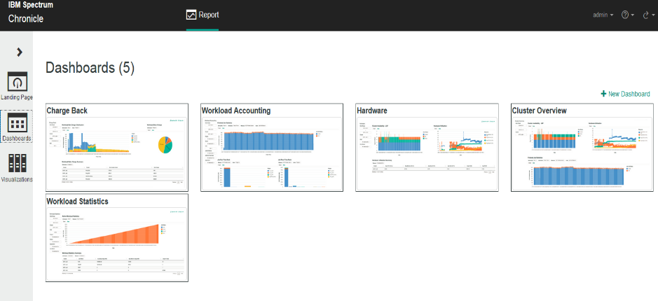
IBM Spectrum LSF Explorer – Overview
Data Collector
Elasticsearch
Web Server
Web browser
Data Collectors
Per Cluster
lsb.events
lsb.acct
Time Series Data
License Data
Scalable Data Store
Near real time query
(Client supplied)
Lightweight
Reporting Engine
Standard Reports & Dashboards
Report Users
Executives, LOB Mgrs., PMs, Analysts
Report designer
Flexible Chart & Dashboards customization
The architecture is aligned with other LSF solutions:
LSF ELK stack for LSF cluster monitoring
Elasticsearch-based LSF command utilities (bhist, bacct) to facilitate query and troubleshooting in second(s)

Slide 17
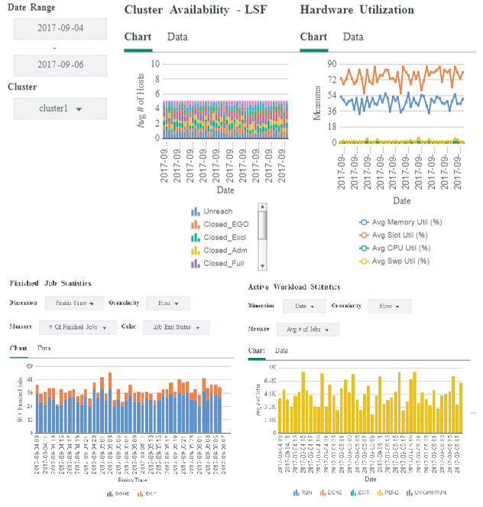
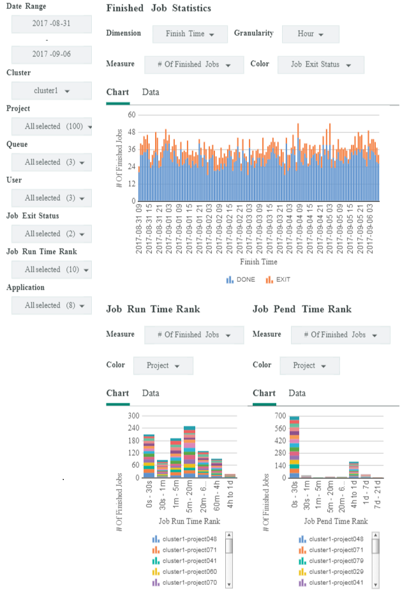
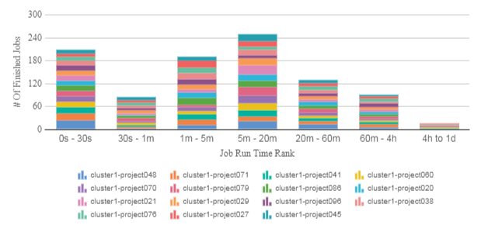
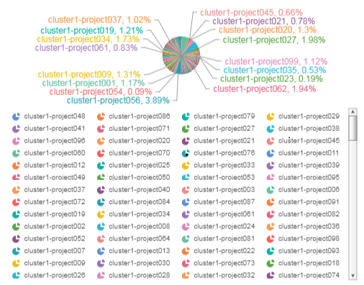
IBM Spectrum LSF Explorer – Sample charts
Job Run Time Rank
Cluster Overview Charts
Workload Accounting Charts
Workload Slot Charge

Slide 18
Orchestrating Resources for Deep Learning (Reducing Jitter) Before LSF
Data scientist
NUMA0
NUMA1
Memory 0
Memory 1
qsub -n 10 ./train.py
CRASH!
Researcher
qsub -n 10 ./train.py
GPU1
GPU2
GPU3
GPU4
© IBM Corporation
18

Slide 19
Orchestrating Resources for Deep Learning (Reducing Jitter) After LSF
Data scientist
NUMA0
NUMA1
Memory 1
Memory 2
bsub -n 10 \ -R “affinity[core(same=numa): \ distribute=pack]” \ -gpu “num=1:mode=exclusive” \ ./train.py
Researcher
bsub -n 10 \ -R “affinity[core(same=numa): \ distribute=pack]” \ -gpu “num=1:mode=exclusive” \ ./train.py
GPU1
GPU2
GPU3
GPU4
© IBM Corporation
19

Slide 20
Webinar am 21.Oktober 15 Uhr
SMB & IBM laden Sie ein zum Webinar
„IBM Spectrum LSF -
Mehr als nur ein Scheduler
Workload Management für HPC
Wir zeigen Ihnen wie Sie mit diesem professionellen Werkzeug das Maximale aus Ihrer HPC Investition herausholen und wie einfach sowohl User und Administratoren Workloads managen können. Teilnehmer erfahren außerdem wie sie das Werkzeug kostenlos ausprobieren können und wie wir bei den ersten Schritten begleiten.
Anmeldung: https://ibm.webex.com/ibm/onstage/g.php?MTID=ea56b2fcaacbb004cfba12000c0de6564
Oder:

